Slide 1

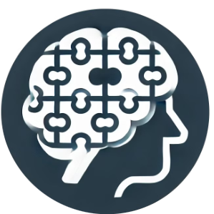

Build Stronger Teams Through Cognitive Insights
Unlock the power of cognitive insights to transform your teams. Enhance hiring, improve performance, and reduce bias. Our platform provides the data-driven solutions you need to build stronger, more effective teams.
by Dr. Gayanga B. Herath

Slide 2
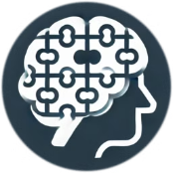



The Challenge: Team Composition & Hiring
Poor Team Fit
Unconscious Bias
Lack of Data
Hiring the wrong person can lead to decreased productivity and morale.
Traditional hiring processes are often influenced by hidden biases.
Many team decisions are based on intuition rather than concrete data.
These issues result in inefficient teams and lost opportunities. Cognitive insights offer a data-driven approach to solve these challenges.

Slide 3
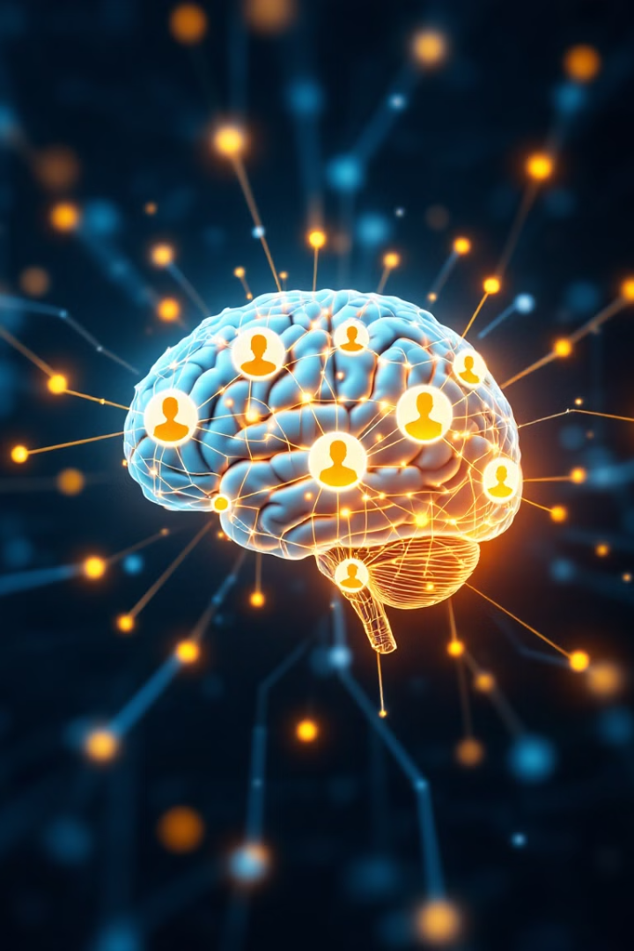
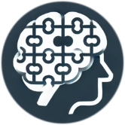



Our Solution: Cognitive Fit Analysis
Data-Driven Decisions
Optimized Team Selection
Make informed hiring decisions based on objective cognitive data.
2
Identify candidates with the cognitive profiles to thrive in your teams.
1
Reduced Hiring Risks
3
Minimize the risks associated with poor team fit and biased hiring.
Our platform ensures every team member contributes effectively. Cognitive Fit Analysis maximizes team success.

Slide 4
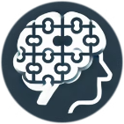
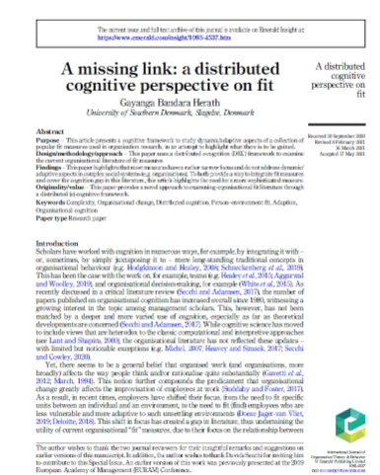
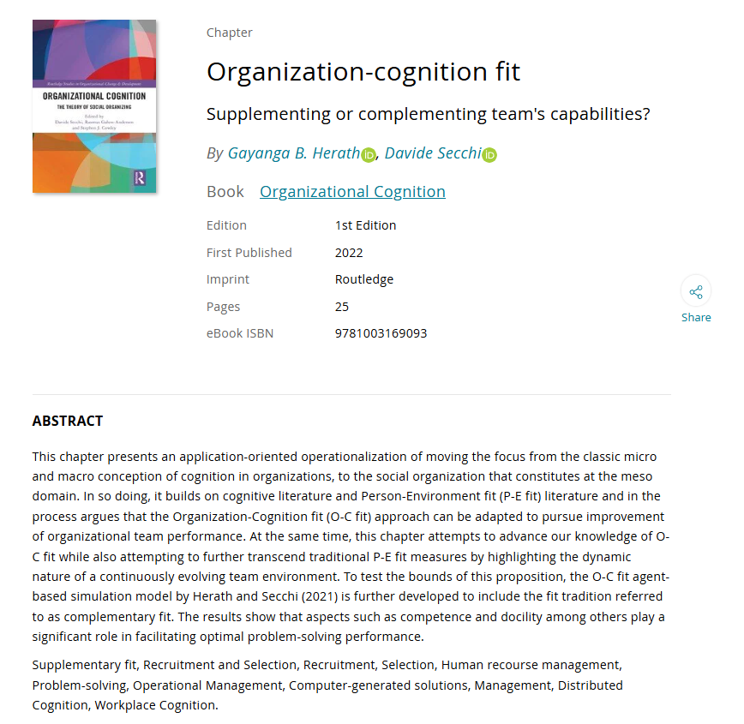
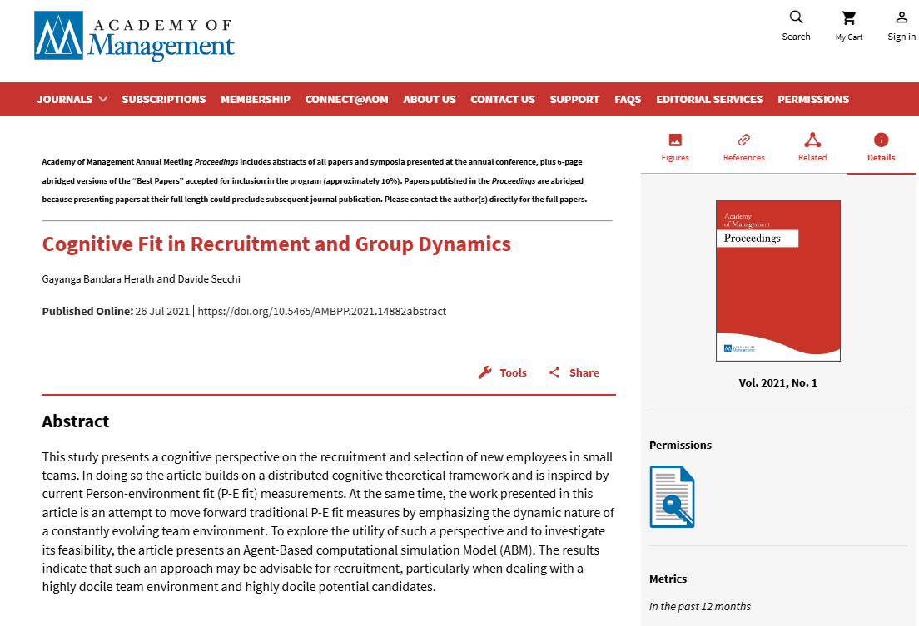
Scientific Research
Research Gap on the missing link in current fit measures
Conceptualising cognitive fit and its benefits in a problem-solving team context
Exploring the utility of Organization-Cognition fit approach
Herath, G.B. (2021), "A missing link: a distributed cognitive perspective on fit", International Journal of Organization Theory & Behavior, Vol. 24 No. 3, pp. 178-196.
Herath, G., & Secchi, D. (2021). Cognitive Fit in Recruitment and Group Dynamics. Academy of Management.
Herath, G. B., & Secchi, D. (2023). Organization-cognition fit: Supplementing or complementing team's capabilities?. In Organizational Cognition (pp. 120-144). Routledge.

Slide 5
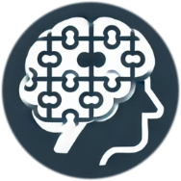




How It Works: A Step-by-Step Process
Input Data
Collect cognitive data from candidates and team members.
Visualize Results
View clear, actionable reports and visualizations.
Analyze Fit
Make Decisions
Our algorithm analyzes cognitive compatibility.
Make informed decisions to build high-performing teams.
From data input to actionable insights, we streamline the team-building process.

Slide 6
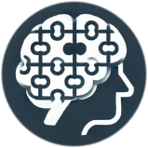





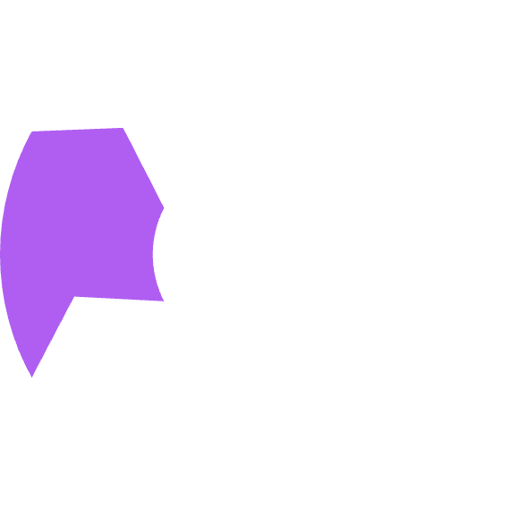






Key Features: Powering Team Success
Our platform offers a comprehensive suite of tools designed to optimize team composition and hiring decisions.
Cognitive Fit Assessment
AI-Powered Matching
Assess cognitive compatibility.
Leverage AI for optimal matches.
Customization Options
Custom Surveys
Customize platform settings.
Tailor surveys to your needs.
Team & Candidate Management
Data Visualization
Manage teams and candidates.
Visualize actionable reports.

Slide 7

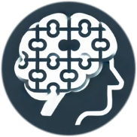




Benefits & Impact: Transforming Team Dynamics
Enhance Hiring
Improve Team Performance
Improve the quality of your hiring decisions.
Build more effective and productive teams.
Reduce Bias
Team Optimization
Create a fair and inclusive hiring process.
Identify team strengths and gaps to build high-performing groups.
Experience the measurable impact of cognitive insights on your team's success. Unlock the full potential of your workforce.

Slide 8



Success Story: Cognitive Fit in Action
Challenge
Solution
Results
Team cohesion and productivity were low, causing frustration and concern.
Cognitive fit analysis was implemented to improve team selection and collaboration.
Team performance increased significantly, and turnover rates were reduced.
Witness the transformative impact of cognitive insights on real-world teams, driving success and fostering a positive work environment.

Slide 9

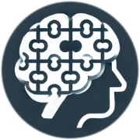
Request a Demo:
See Cognitive Insights in Action
Ready to revolutionize your team-building process? Contact us today to schedule a demo. Discover how cognitive insights can transform your teams. Build stronger, more effective teams today.

